Slide 1
TOOL I.D.

Slide 2
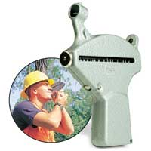
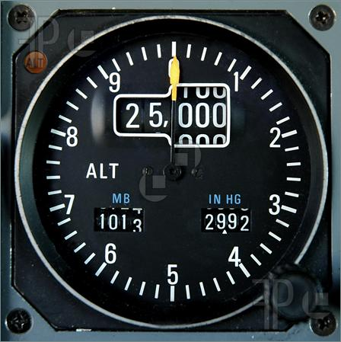
Altimeter

Slide 3
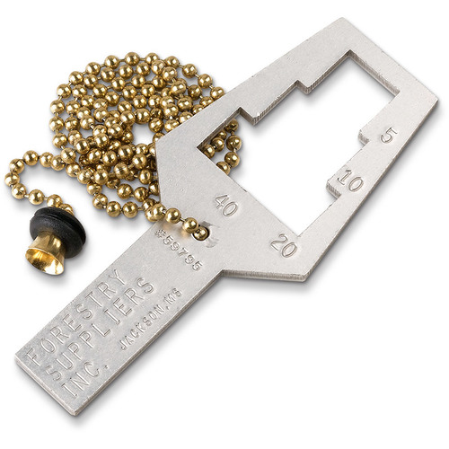
Angle Gauge

Slide 4
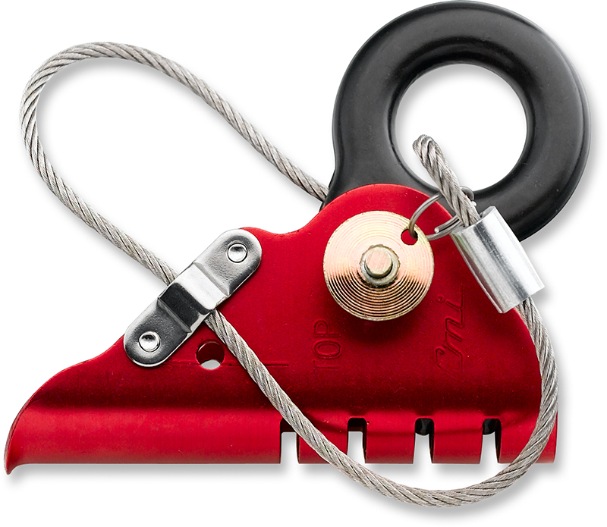
Ascender

Slide 5
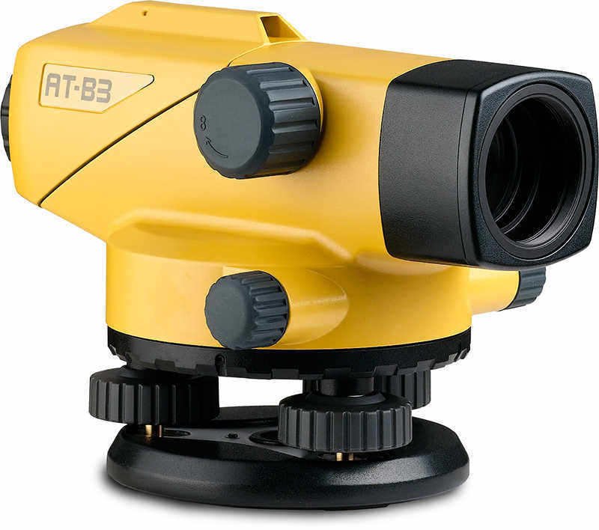
Automatic Level

Slide 6
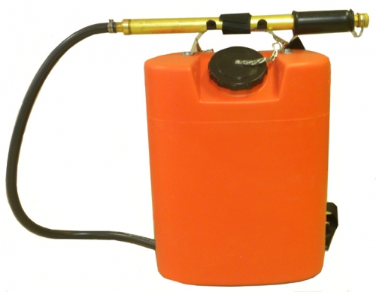
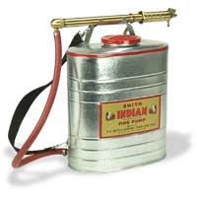
Back-pack Fire Pump

Slide 7
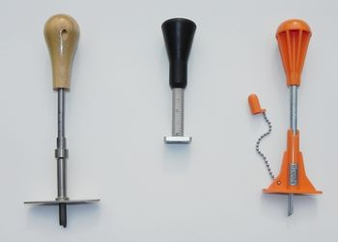
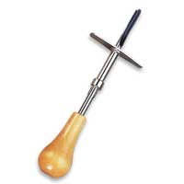
Bark Gauge

Slide 8
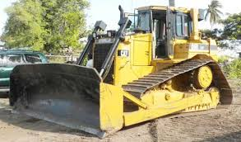
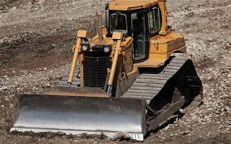
Bulldozer

Slide 9
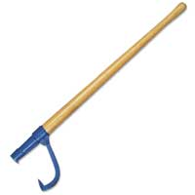
Canthook – Blunt End

Slide 10
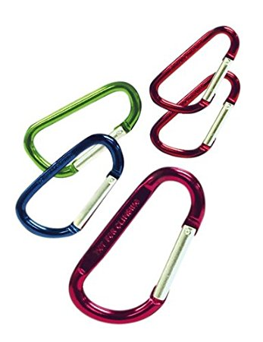
Carabiner

Slide 11
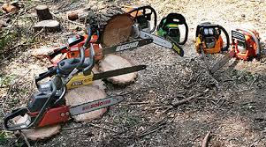
Chainsaw

Slide 12
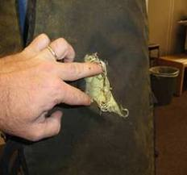
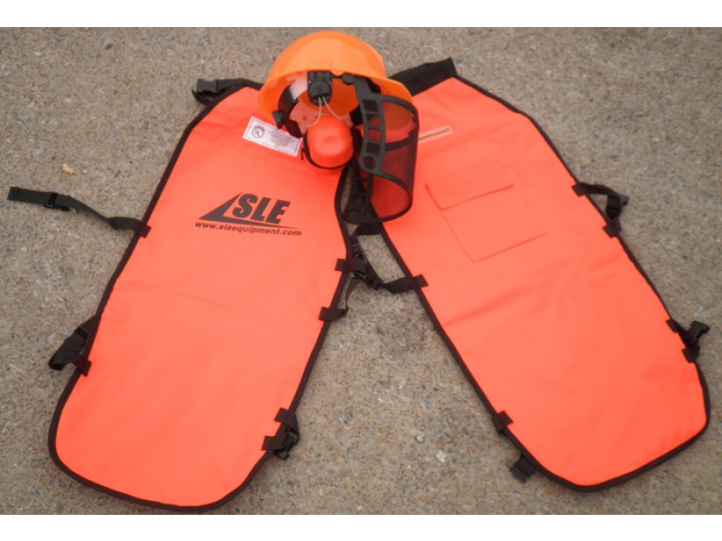
Chainsaw Chaps

Slide 13
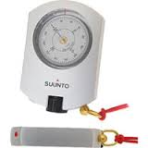
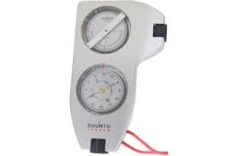
Clinometer

Slide 14
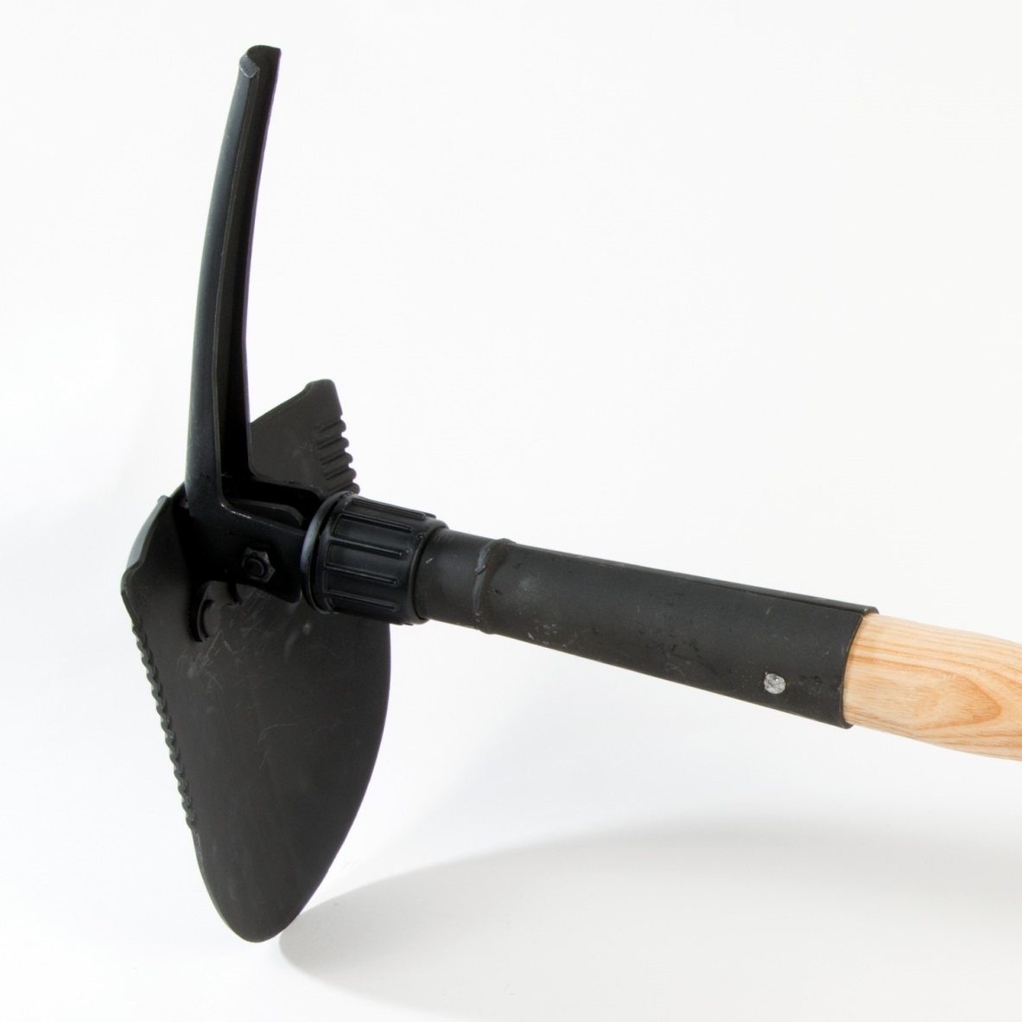
Combination Tool

Slide 15
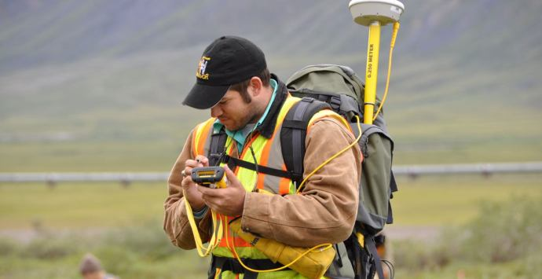
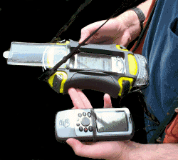
Data Recorder

Slide 16
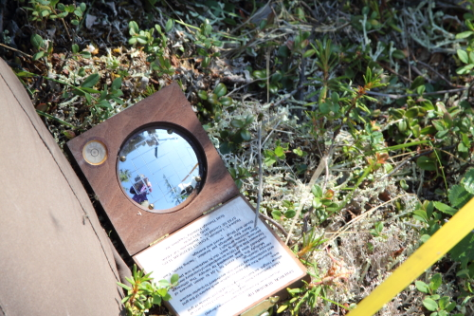
Densiometer

Slide 17
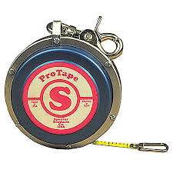
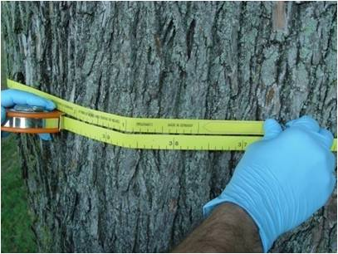
Diameter Tape

Slide 18
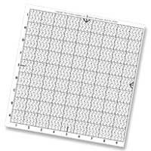
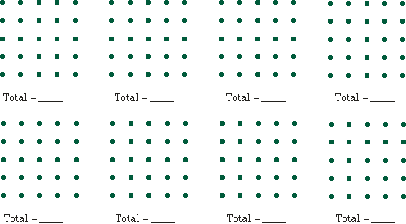
Dot Grid

Slide 19
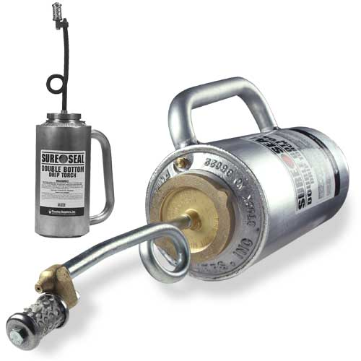
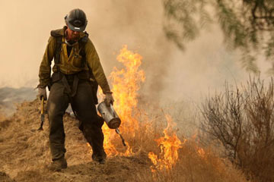
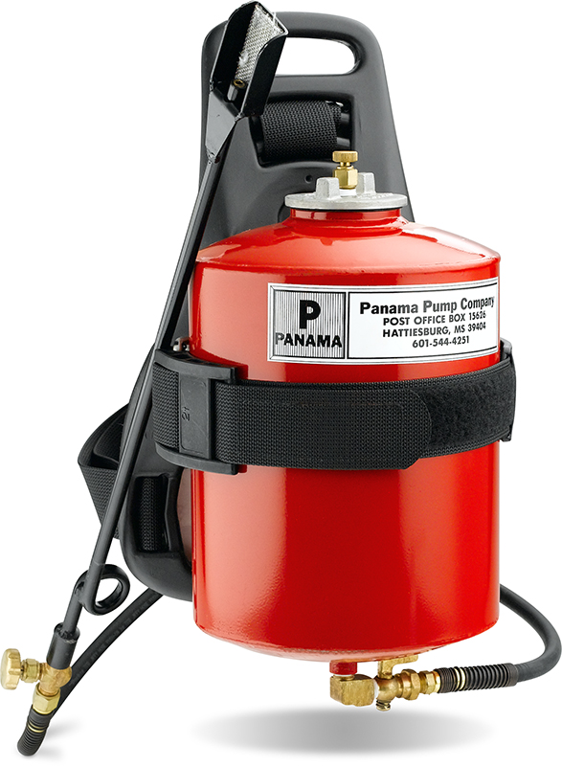
Drip Torch

Slide 20
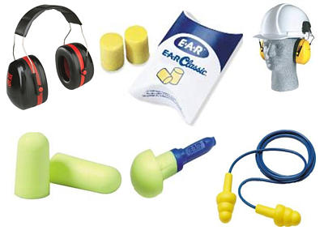
Ear Protection

Slide 21
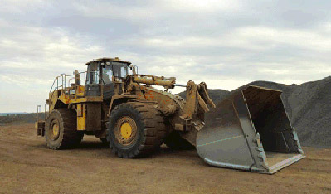
Endloader

Slide 22
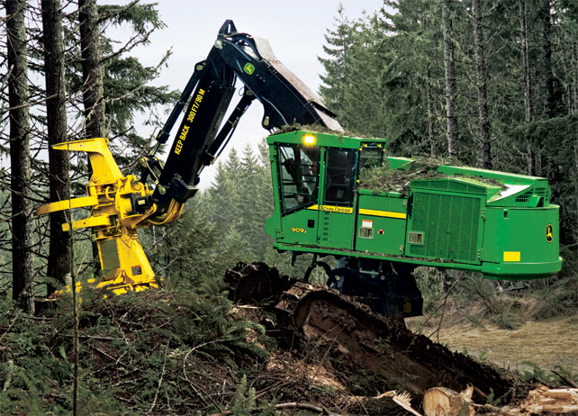
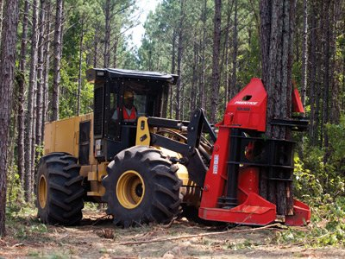
Feller Buncher

Slide 23
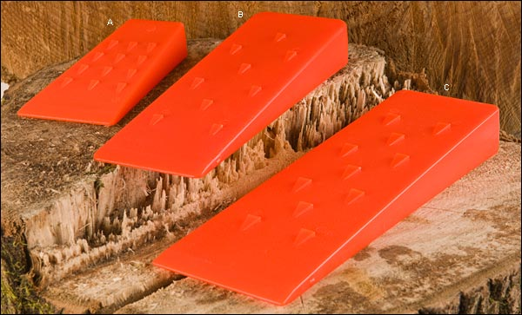
Felling Wedge

Slide 24
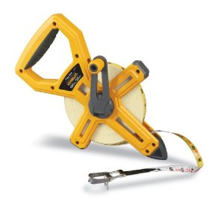
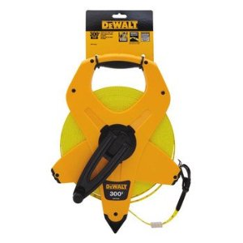
Fiber Glass Measuring Tape

Slide 25
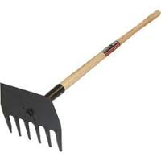
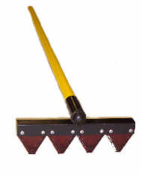
Fire Rake

Slide 26
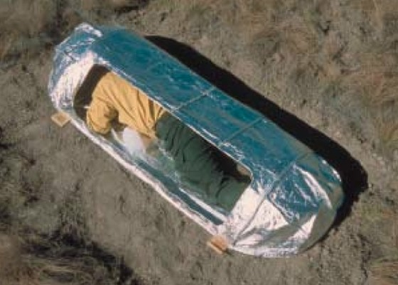
Fire Shelter

Slide 27
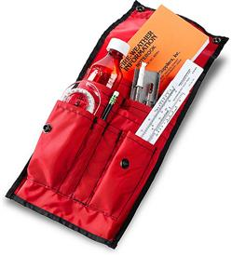
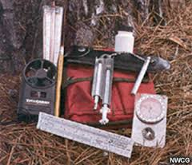
Fire Weather Kit

Slide 28
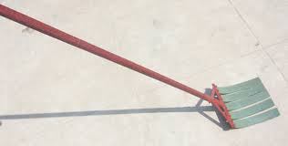
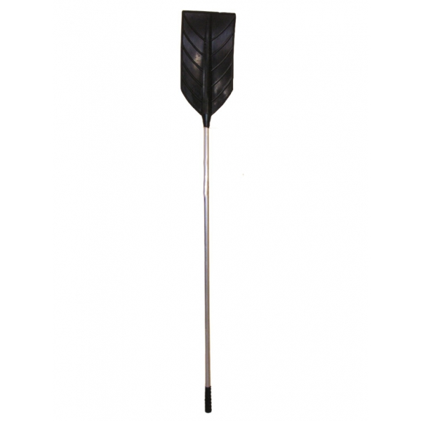
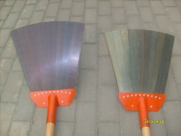
Fire Swatter

Slide 29
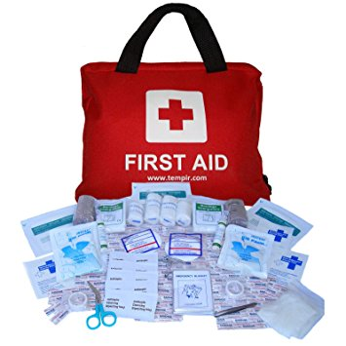
First Aid Kit

Slide 30
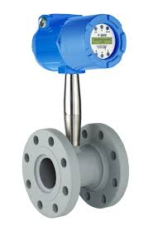
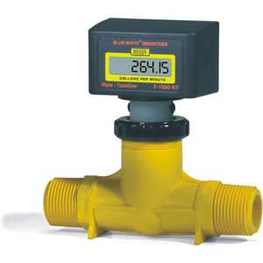
Flow/current Meter

Slide 31
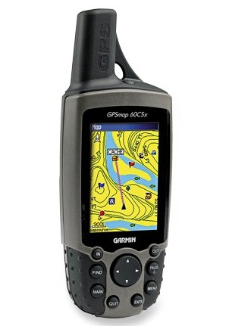
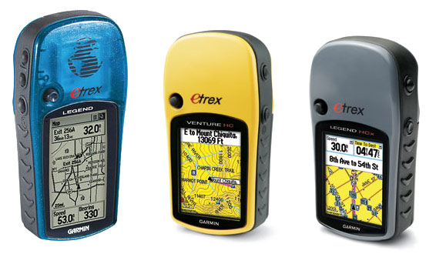
GPS Receiver

Slide 32
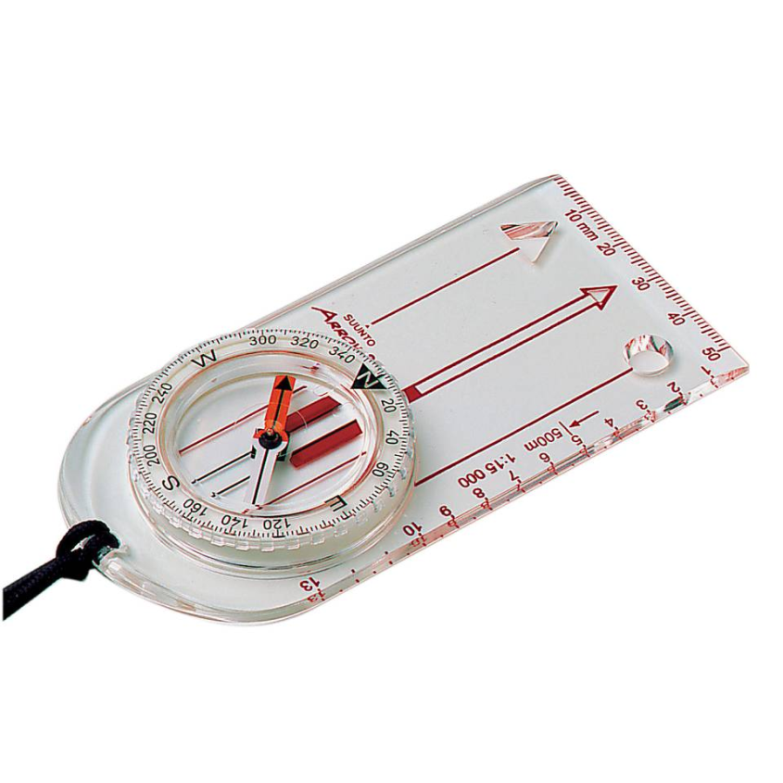
Hand Compass

Slide 33
Hand Lens/ Field Microscope

Slide 34
Hip Chain

Slide 35
Hypo-Hatchet

Slide 36
Increment Borer

Slide 37
Jacob Staff

Slide 38
Log Rule

Slide 39
Loggers Tape

Slide 40
Maul

Slide 41
Peavy

Slide 42
Ph Meter

Slide 43
Planimeter

Slide 44
Plant Press

Slide 45
Plastic Flagging

Slide 46
Pole Saw

Slide 47
Pruning Saw

Slide 48
Pulaski Forester Axe

Slide 49
Relascop

Slide 50
Safety Glasses

Slide 51
Safety Hard Hat

Slide 52
Scale Stick

Slide 53
Secchi Disc

Slide 54
Soil Sampler

Slide 55
Soil Test Kit

Slide 56
Staff Compass

Slide 57
Staff Compass

Slide 58
Stereoscope

Slide 59
Tally Book

Slide 60
Tally Meter

Slide 61
Timber Tongs

Slide 62
Tree Caliper

Slide 63
Tree Harvester

Slide 64
Tree Marking Gun

Slide 65
Tree Planting Hoe or Bar

Slide 66
Tree Skidder

Slide 67
Water Sampler

Slide 68
Water Test Kit

Slide 69
Wedge Prism

